Slide 1
Controlling the Page Navigation
(Section 1)

Slide 2
URL view activity
public String getEmpViewURL() {
String viewId = "empView";
ControllerContext controllerCtx = ControllerContext.getInstance();
return controllerCtx.getGlobalViewActivityURL(viewId);
}
getGlobalViewActivityURL(): This method generates a URL for a view activity in the unbounded task flow
getLocalViewActivityURL(): This method generates a URL for a view activity in the bounded task flow
You can use the previously mentioned encoding APIs to identify the correct URL from the view ID even when you call the redirect() method on the javax.faces.context.ExternalContext instance in your code.

Slide 3
URL view activity
public String getEmpViewURL() {
String viewId = "empView";
ControllerContext controllerCtx = ControllerContext.getInstance();
return controllerCtx.getGlobalViewActivityURL(viewId);
}
getGlobalViewActivityURL(): This method generates a URL for a view activity in the unbounded task flow
getLocalViewActivityURL(): This method generates a URL for a view activity in the bounded task flow
You can use the previously mentioned encoding APIs to identify the correct URL from the view ID even when you call the redirect() method on the javax.faces.context.ExternalContext instance in your code.

Slide 4
What happens when runtime invokes a URL view activity from a bounded task flow?
When runtime invokes a URL activity from a bounded task flow, before navigating to a new URL view, the framework abandons the ongoing task flow process and clears the memory scopes variables for the task flow. In other words, invoking a URL view activity is the same as exiting from a current task flow and invoking the target view.

Slide 5
Method call activity
Method call activity allows a task flow to call custom or built-in methods during view transitions. This is useful to execute some business logic before page renders. Method call activity represents a method defined in a managed bean, or a method exposed in data control which is referred through ADF binding.
Using a managed bean method in method call activity
You should specify the outcome for the method call activity using the following options:
Fixed Outcome
toString
To specify parameters for the method, expand the Parameters section and enter the parameter type and value as they appear in the method signature.

Slide 6
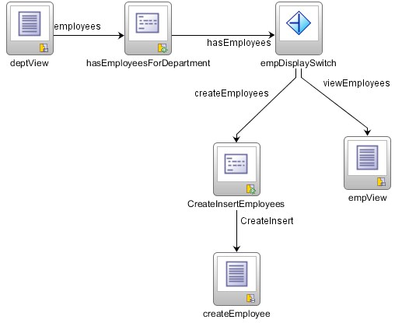
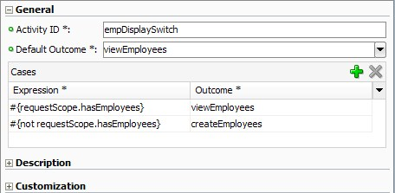
Router activity

Slide 7
Router activity
A router activity selects one of many possible activities to execute. This takes an EL expression as selection criteria and defines possible matching navigation cases. Based on the outcome of the evaluation of the EL expression, the framework chooses the matching navigation case and continues the execution with the target activity.
Default Outcome: This is the default outcome for the router activity which will be used when no control flow cases evaluate to true.
Navigation Cases: The following are the navigation cases.
Expression: This specifies an EL expression that evaluates to true or false at runtime.
Outcome: This specifies the outcome for the router activity if the expression evaluates to true.

Slide 8
Save point restore activity
The save point feature provided by ADF Controller can be used for capturing a snapshot of the application state at a specific point in time. The Save Point Restore activity declaratively enables the application to restore whatever was captured when the save point was originally created. This is typically used for implementing the undo feature in task flows.

Slide 9
Where are ADF Controller save points created?
Save points are configured to save database tables by default. The default expiry time for a save point is 86400 seconds (24 hours). The ADF framework uses the ORADFCSAVPT table to store the save points. The framework will try to create this table if it is missing in the database when it is accessed for the first time. However the database user should have necessary privileges to create a table.
To Change table datasource : adf-config.xml -> Savepoints

Slide 10
Using save points in a task flow
To declaratively define a save point in a task flow, drop a method call activity on to the task flow editor diagram and in the property inspector specify the following EL expression as a method to be invoked: #{controllerContext.savePointManager. createSavePoint}. This expression is equivalent to calling the createSavePoint() method on SavePointManager as shown in the following code snippet:
ControllerContext ccntxt = ControllerContext.getInstance();
SavePointManager savePointManager = ccntxt.getSavePointManager();
String savePointId = savePointManager.createSavePoint();

Slide 11
What happens when you create an ADF Controller save point?
Save point captures the following state information for an application:
User Interface state: This includes the selection state of selection-enabled UI components and user customizations such as table column sort state.
Managed beans: This specifies the state of underlying managed beans stored in session, view, and pageflow memory scopes. Managed beans should be serializable to save their state.
Navigation state: This includes task flow call stack tracks to restore the path to reach the current page.
ADF model state: This specifies the state of underlying business components which includes the modified state of entity objects, conditions used for querying the data source, row currency for the row sets, and passivation-enabled transient attribute values of entity and view objects.
PS_TXN table is for Application module

Slide 12
Implicit save points
ADF Controller also has support for enabling implicit save points. This helps to automatically save the current state of the bounded task flow in two cases:
When an Http session is invalidated
When a browser window is closed
To enable implicit save points for the application, open adf-config.xml in the overview editor and select the Controller page. Select the Enable Implicit Savepoint checkbox option displayed under the Savepoints section in order to turn on the implicit save point for the application.

